Slide 1
Basic widgets and layouts
Thai Duy Quy

Slide 2


Android – User Interfaces Using XML Layouts

Slide 3

The View Class
The View class represents the basic building block for user interface components.
A View occupies a rectangular area on the screen and is responsible for drawing and event handling.
View is the base class for widgets, which are used to create interactive UI components (buttons, text fields, etc.).
3

Slide 4
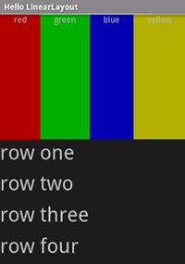
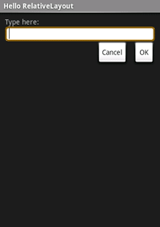
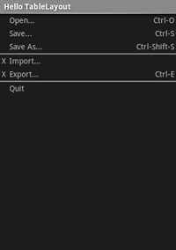
A brief sample of UI components
Layouts
Linear Layout
Relative Layout
Table Layout
4

Slide 5
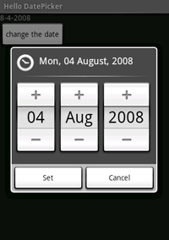
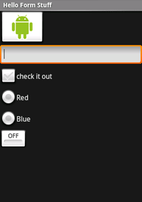
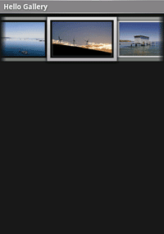
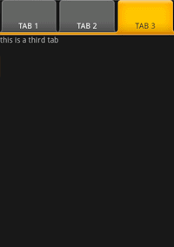
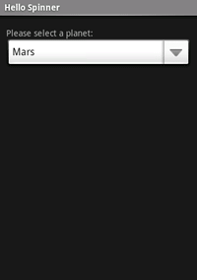
A brief sample of UI components
Widgets
GalleryView
TabWidget
Spinner
DatePicker
Form Controls
5

Slide 6
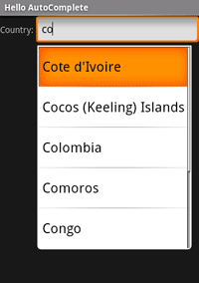
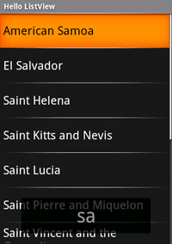
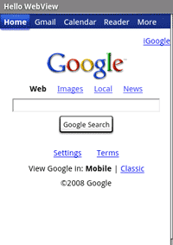
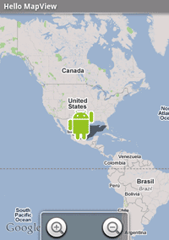
A brief sample of UI components
WebView
MapView
AutoCompleteTextView
ListView
6

Slide 7
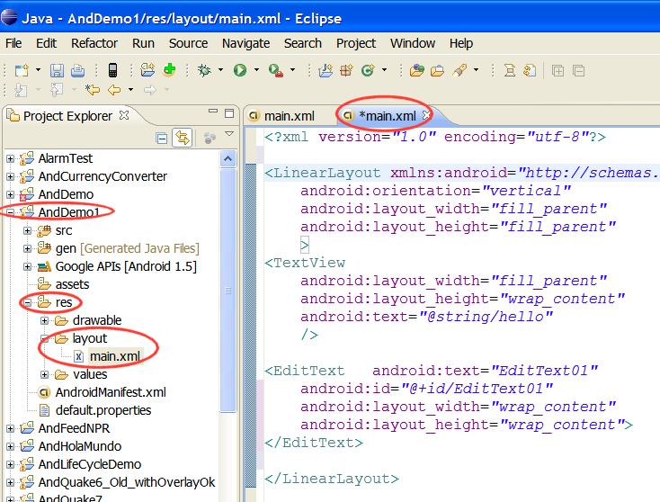
What is an XML Layout?
An XML-based layout is a specification of the various UI components (widgets) and the relationships to each other – and to their containers – all written in XML format.
Android considers XML-based layouts to be resources, and as such layout files are stored in the res/layout directory inside your Android project.
7

Slide 8
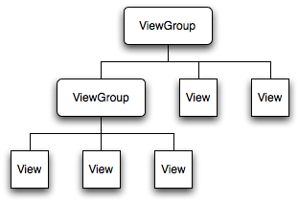
Android Layouts
Each element in the XML Layout is either a View or ViewGroup object
8

Slide 9
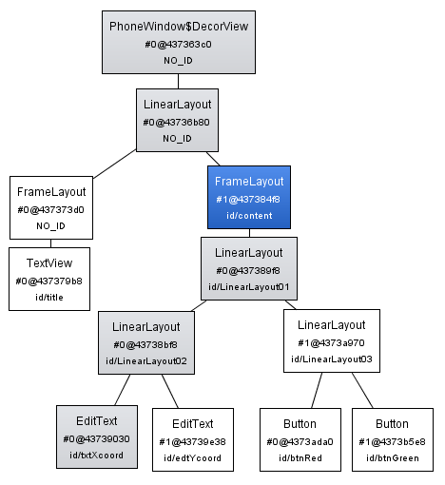
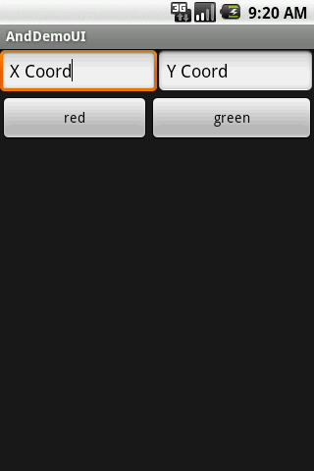
Android Layouts
Example: Display UI Hierarchy
Using SDK older than r8.
vertical
Horizontal 1
Horizontal 2
See: Android – Application Development, by R. Rogers et al. O’Reilly Pub. 2009, ISBN 978-0-596-52147-0
9

Slide 10
4. Android – UI - User Interfaces
Common Layouts
There are five basic types of Layouts:
Frame, Linear, Relative, Table, and Absolute.
1. FrameLayout
FrameLayout is the simplest type of layout object. It's basically a blank space on your screen that you can later fill with a single object — for example, a picture that you'll swap in and out.
All child elements of the FrameLayout are pinned to the top left corner of the screen; you cannot specify a different location for a child view.
Subsequent child views will simply be drawn over previous ones, partially or totally obscuring them (unless the newer object is transparent).
10

Slide 11
4. Android – UI - User Interfaces
Common Layouts
2. LinearLayout
LinearLayout aligns all children in a single direction — vertically or horizontally depending on the android:orientation attribute.
All children are stacked one after the other, so a
vertical list will only have one child per row, no matter how wide they are, and a
horizontal list will only be one row high (the height of the tallest child, plus padding).
A LinearLayout respects margins between children and the gravity (right, center, or left alignment) of each child.
11

Slide 12
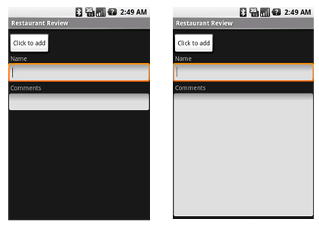
4. Android – UI - User Interfaces
Common Layouts
2. LinearLayout
You may attribute a weight to children of a LinearLayout.
Weight gives an "importance" value to a view, and allows it to expand to fill any remaining space in the parent view.
Example:
The following two forms represent a LinearLayout with a set of elements: a button, some labels and text boxes. The text boxes have their width set to fill_parent; other elements are set to wrap_content. The gravity, by default, is left.
The difference between the two versions of the form is that the form on the left has weight values unset (0 by default), while the form on the right has the comments text box weight set to 1. If the Name textbox had also been set to 1, the Name and Comments text boxes would be the same height.
12

Slide 13
4. Android – UI - User Interfaces
Common Layouts
3. TableLayout
TableLayout positions its children into rows and columns.
TableLayout containers do not display border lines.
The table will have as many columns as the row with the most cells.
A cell could be empty, but cannot span columns, as they can in HTML.
A TableRow object defines a single row in the table.
A row has zero or more cells, each cell is defined by any kind of other View.
A cell may also be a ViewGroup object.
13

Slide 14
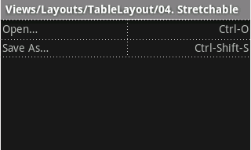
4. Android – UI - User Interfaces
Common Layouts
<?xml version="1.0" encoding="utf-8"?>
<TableLayout
xmlns:android="http://schemas.android.com/apk/res/android"
android:layout_width="fill_parent"
android:layout_height="fill_parent"
android:stretchColumns="*">
<TableRow>
<TextView android:text="Open…"
android:padding="3dip" />
<TextView android:text="Ctrl-O"
android:gravity="right"
android:padding="3dip" />
</TableRow>
<TableRow>
<TextView android:text="Save As…"
android:padding="3dip" />
<TextView android:text="Ctrl-Shift-S"
android:gravity="right"
android:padding="3dip" />
</TableRow>
</TableLayout>
TableLayout Example
The following sample layout has two rows and two cells in each. The accompanying screenshot shows the result, with cell borders displayed as dotted lines (added for visual effect).
14

Slide 15
4. Android – UI - User Interfaces
Common Layouts
4. RelativeLayout
RelativeLayout lets child views specify their position relative to the parent view or to each other (specified by ID).
You can align two elements by right border, or make one below another, centered in the screen, centered left, and so on.
Elements are rendered in the order given, so if the first element is centered in the screen, other elements aligning themselves to that element will be aligned relative to screen center.
Also, because of this ordering, if using XML to specify this layout, the element that you will reference (in order to position other view objects) must be listed in the XML file before you refer to it from the other views via its reference ID.
15

Slide 16
4. Android – UI - User Interfaces
Common Layouts
4. RelativeLayout
The defined RelativeLayout parameters are (android:layout_...) :
width, height,
below, above
alignTop, alignParentTop,
alignBottom, alignParentBottom
toLeftOf, toRightOf
padding [Bottom|Left|Right|Top], and
margin [Bottom|Left|Right|Top].
For example, assigning the parameter
android:layout_toLeftOf=“@+id/my_button"
to a TextView would place the TextView to the left of the View with the ID my_button
16

Slide 17
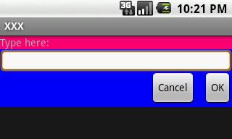
4. Android – UI - User Interfaces
Common Layouts
<?xml version="1.0" encoding="utf-8"?>
<RelativeLayout
xmlns:android="http://schemas.android.com/apk/res/android"
android:layout_width="fill_parent"
android:layout_height="wrap_content"
android:background="#ff0000ff"
android:padding="10px" >
<TextView android:id="@+id/label"
android:layout_width="fill_parent"
android:layout_height="wrap_content"
android:background="#ffff0077"
android:text="Type here:" />
<EditText android:id="@+id/entry"
android:layout_width="fill_parent"
android:layout_height="wrap_content"
android:layout_below="@+id/label" />
RelativeLayout Example
The example below shows an XML file and the resulting screen in the UI. Note that the attributes that refer to relative elements (e.g., layout_toLeft) refer to the ID using the syntax of a relative resource (@+id/id).
Continue next page
17

Slide 18
4. Android – UI - User Interfaces
Common Layouts
<Button
android:id="@+id/ok"
android:layout_width="wrap_content"
android:layout_height="wrap_content"
android:layout_below="@+id/entry"
android:layout_alignParentRight="true"
android:layout_marginLeft="10px"
android:text="OK" />
<Button
android:text="Cancel"
android:layout_width="wrap_content"
android:layout_height="wrap_content"
android:layout_toLeftOf="@+id/ok"
android:layout_alignTop="@+id/ok“ />
</RelativeLayout>
RelativeLayout Example
Cont.
18

Slide 19
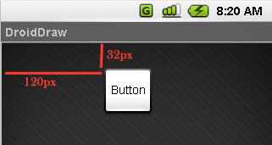
4. Android – UI - User Interfaces
Common Layouts
5. AbsoluteLayout
A layout that lets you specify exact locations (x/y coordinates) of its children. Absolute layouts are less flexible and harder to maintain than other types of layouts without absolute positioning.
<?xml version="1.0" encoding="utf-8"?>
<AbsoluteLayout
android:id="@+id/myAbsoluteLayout"
android:layout_width="fill_parent"
android:layout_height="fill_parent"
xmlns:android="http://schemas.android.com/apk/res/android" >
<Button
android:id="@+id/myButton"
android:layout_width="wrap_content"
android:layout_height="wrap_content"
android:text="Button"
android:layout_x=“120px"
android:layout_y=“32px"
>
</Button>
</AbsoluteLayout>
19

Slide 20
A Detailed List of Widgets
For a detailed list consult:
http://developer.android.com/reference/android/widget/package-summary.html
AbsListView
AbsListView.LayoutParams
AbsoluteLayout
AbsoluteLayout.LayoutParams
AbsSeekBar
AbsSpinner
AdapterView<T extends Adapter>
AdapterContextMenuInfo
AlphabetIndexer
AnalogClock
ArrayAdapter<T>
AutoCompleteTextView
BaseAdapter
BaseExpandableListAdapter
Button
CheckBox
CheckedTextView
Chronometer
CompoundButton
CursorAdapter
CursorTreeAdapter
DatePicker
DialerFilter
DigitalClock
EditText
ExpandableListView
ExpandableListContextMenuInfo
Filter
Filter.FilterResults
FrameLayout
FrameLayout.LayoutParams
Gallery
Gallery.LayoutParams
GridView
HeaderViewListAdapter
HorizontalScrollView
ImageButton
ImageSwitcher
ImageView
LinearLayout
LinearLayout.LayoutParams
ListView
ListView.FixedViewInfo
MediaController
MultiAutoCompleteTextView
CommaTokenizer
PopupWindow
ProgressBar
RadioButton
RadioGroup
RadioGroup.LayoutParams
RatingBar
RelativeLayout
RelativeLayout.LayoutParams
RemoteViews
ResourceCursorAdapter
ResourceCursorTreeAdapter
Scroller
ScrollView
SeekBar
SimpleAdapter
SimpleCursorAdapter
SimpleCursorTreeAdapter
SimpleExpandableListAdapter
SlidingDrawer
Spinner
TabHost
TabHost.TabSpec
TableLayout
TableLayout.LayoutParams
TableRow
TableRow.LayoutParams
TabWidget
TextSwitcher
TextView
TextView.SavedState
TimePicker
Toast
ToggleButton
TwoLineListItem
VideoView
ViewAnimator
ViewFlipper
ViewSwitcher
ZoomButton
ZoomControls
20

Slide 21
Attaching Layouts to Java Code
You must ‘connect’ the XML elements with equivalent objects in your Java activity. This allows you to manipulate the UI with code.
XLM Layout
<xml….
. . .
. . .
</xml>
JAVA code
pucbli class ….
{
. . .
. . .
}
21

Slide 22
Attaching Layouts to Java Code
Assume the UI in res/layout/main.xml has been created. This layout could be called by an application using the statement
setContentView(R.layout.main);
Individual widgets, such as myButton could be accessed by the application using the statement findViewByID(...) as in
Button btn = (Button) findViewById(R.id.myButton);
Where R is a class automatically generated to keep track of resources available to the application. In particular R.id... is the collection of widgets defined in the XML layout.
22

Slide 23
Attaching Layouts to Java Code
Attaching Listeners to the Widgets
The button of our example could now be used, for instance a listener for the click event could be written as:
btn.setOnClickListener(new OnClickListener() {
@Override
public void onClick(View v) {
updateTime();
}
});
private void updateTime() {
btn.setText(new Date().toString());
}
23

Slide 24
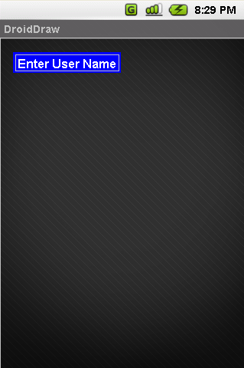
Basic Widgets: Labels
A label is called in android a TextView.
TextViews are typically used to display a caption.
TextViews are not editable, therefore they take no input.
24

Slide 25
Basic Widgets: Labels
<?xml version="1.0" encoding="utf-8"?>
<AbsoluteLayout
android:id="@+id/absLayout"
android:layout_width="fill_parent" android:layout_height="fill_parent"
xmlns:android="http://schemas.android.com/apk/res/android"
>
<TextView
android:id="@+id/myTextView1"
android:layout_width="wrap_content"
android:layout_height="wrap_content"
android:background="#ff0000ff"
android:padding="3px"
android:text="Enter User Name"
android:textSize="16sp"
android:textStyle="bold"
android:gravity="center"
android:layout_x="20px"
android:layout_y="22px“ >
</TextView>
</AbsoluteLayout>
25

Slide 26
Basic Widgets: Labels/TextViews
Attribute Name | Related Method | Description
android:autoLink | setAutoLinkMask(int) | Controls whether links such as urls and email addresses are automatically found and converted to clickable links.
android:autoText | setKeyListener(KeyListener) | If set, specifies that this TextView has a textual input method and automatically corrects some common spelling errors.
android:bufferType | setText(CharSequence,TextView.BufferType) | Determines the minimum type that getText() will return.
android:capitalize | setKeyListener(KeyListener) | If set, specifies that this TextView has a textual input method and should automatically capitalize what the user types.
android:cursorVisible | setCursorVisible(boolean) | Makes the cursor visible (the default) or invisible Must be a boolean value, either "true" or "false".
android:digits | setKeyListener(KeyListener) | If set, specifies that this TextView has a numeric input method and that these specific characters are the ones that it will accept.
android:drawableBottom | setCompoundDrawablesWithIntrinsicBounds(Drawable,Drawable,Drawable,Drawable) | The drawable to be drawn below the text.
android:drawableLeft | setCompoundDrawablesWithIntrinsicBounds(Drawable,Drawable,Drawable,Drawable) | The drawable to be drawn to the left of the text.
android:drawablePadding | setCompoundDrawablePadding(int) | The padding between the drawables and the text.
android:drawableRight | setCompoundDrawablesWithIntrinsicBounds(Drawable,Drawable,Drawable,Drawable) | The drawable to be drawn to the right of the text.
android:drawableTop | setCompoundDrawablesWithIntrinsicBounds(Drawable,Drawable,Drawable,Drawable) | The drawable to be drawn above the text.
android:editable |  | If set, specifies that this TextView has an input method.
android:editorExtras | setInputExtras(int) | Reference to an <input-extras> XML resource containing additional data to supply to an input method, which is private to the implementation of the input method.
android:ellipsize | setEllipsize(TextUtils.TruncateAt) | If set, causes words that are longer than the view is wide to be ellipsized instead of broken in the middle.
android:ems | setEms(int) | Makes the TextView be exactly this many ems wide Must be an integer value, such as "100".
android:freezesText | setFreezesText(boolean) | If set, the text view will include its current complete text inside of its frozen icicle in addition to meta-data such as the current cursor position.
26

Slide 27
Basic Widgets: Labels/TextViews cont.
Attribute Name | Related Method | Description
android:gravity | setGravity(int) | Specifies how to align the text by the view's x and/or y axis when the text is smaller than the view.
android:height | setHeight(int) | Makes the TextView be exactly this many pixels tall.
android:hint | setHint(int) | Hint text to display when the text is empty.
android:imeActionId | setImeActionLabel(CharSequence,int) | Supply a value for EditorInfo.actionId used when an input method is connected to the text view.
android:imeActionLabel | setImeActionLabel(CharSequence,int) | Supply a value for EditorInfo.actionLabel used when an input method is connected to the text view.
android:imeOptions | setImeOptions(int) | Additional features you can enable in an IME associated with an editor, to improve the integration with your application.
android:includeFontPadding | setIncludeFontPadding(boolean) | Leave enough room for ascenders and descenders instead of using the font ascent and descent strictly.
android:inputMethod | setKeyListener(KeyListener) | If set, specifies that this TextView should use the specified input method (specified by fully-qualified class name).
android:inputType | setRawInputType(int) | The type of data being placed in a text field, used to help an input method decide how to let the user enter text.
android:lineSpacingExtra | setLineSpacing(float,float) | Extra spacing between lines of text.
android:lineSpacingMultiplier | setLineSpacing(float,float) | Extra spacing between lines of text, as a multiplier.
android:lines | setLines(int) | Makes the TextView be exactly this many lines tall Must be an integer value, such as "100".
android:linksClickable | setLinksClickable(boolean) | If set to false, keeps the movement method from being set to the link movement method even if autoLink causes links to be found.
android:marqueeRepeatLimit | setMarqueeRepeatLimit(int) | The number of times to repeat the marquee animation.
android:maxEms | setMaxEms(int) | Makes the TextView be at most this many ems wide Must be an integer value, such as "100".
android:maxHeight | setMaxHeight(int) | Makes the TextView be at most this many pixels tall Must be a dimension value, which is a floating point number appended with a unit such as "14.5sp".
android:maxLength | setFilters(InputFilter) | Set an input filter to constrain the text length to the specified number.
android:maxLines | setMaxLines(int) | Makes the TextView be at most this many lines tall Must be an integer value, such as "100".
27

Slide 28
Basic Widgets: Labels/TextViews cont.
Attribute Name | Related Method | Description
android:maxWidth | setMaxWidth(int) | Makes the TextView be at most this many pixels wide Must be a dimension value, which is a floating point number appended with a unit such as "14.5sp".
android:minEms | setMinEms(int) | Makes the TextView be at least this many ems wide Must be an integer value, such as "100".
android:minHeight | setMinHeight(int) | Makes the TextView be at least this many pixels tall Must be a dimension value, which is a floating point number appended with a unit such as "14.5sp".
android:minLines | setMinLines(int) | Makes the TextView be at least this many lines tall Must be an integer value, such as "100".
android:minWidth | setMinWidth(int) | Makes the TextView be at least this many pixels wide Must be a dimension value, which is a floating point number appended with a unit such as "14.5sp".
android:numeric | setKeyListener(KeyListener) | If set, specifies that this TextView has a numeric input method.
android:password | setTransformationMethod(TransformationMethod) | Whether the characters of the field are displayed as password dots instead of themselves.
android:phoneNumber | setKeyListener(KeyListener) | If set, specifies that this TextView has a phone number input method.
android:privateImeOptions | setPrivateImeOptions(String) | An addition content type description to supply to the input method attached to the text view, which is private to the implementation of the input method.
android:scrollHorizontally | setHorizontallyScrolling(boolean) | Whether the text is allowed to be wider than the view (and therefore can be scrolled horizontally).
android:selectAllOnFocus | setSelectAllOnFocus(boolean) | If the text is selectable, select it all when the view takes focus instead of moving the cursor to the start or end.
android:shadowColor | setShadowLayer(float,float,float,int) | Place a shadow of the specified color behind the text.
android:shadowDx | setShadowLayer(float,float,float,int) | Horizontal offset of the shadow.
android:shadowDy | setShadowLayer(float,float,float,int) | Vertical offset of the shadow.
android:shadowRadius | setShadowLayer(float,float,float,int) | Radius of the shadow.
28

Slide 29
Basic Widgets: Labels/TextViews cont.
Attribute Name | Related Method | Description
android:singleLine | setTransformationMethod(TransformationMethod) | Constrains the text to a single horizontally scrolling line instead of letting it wrap onto multiple lines, and advances focus instead of inserting a newline when you press the enter key.
android:text | setText(CharSequence) | Text to display.
android:textColor | setTextColor(ColorStateList) | Text color.
android:textColorHighlight | setHighlightColor(int) | Color of the text selection highlight.
android:textColorHint | setHintTextColor(int) | Color of the hint text.
android:textColorLink | setLinkTextColor(int) | Text color for links.
android:textScaleX | setTextScaleX(float) | Sets the horizontal scaling factor for the text Must be a floating point value, such as "1.2".
android:textSize | setTextSize(float) | Size of the text.
android:textStyle | setTypeface(Typeface) | Style (bold, italic, bolditalic) for the text.
android:typeface | setTypeface(Typeface) | Typeface (normal, sans, serif, monospace) for the text.
android:width | setWidth(int) | Makes the TextView be exactly this many pixels wide.
29

Slide 30
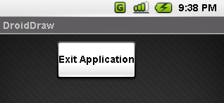
Basic Widgets: Buttons
A Button widget allows the simulation of a clicking action on a GUI.
Button is a subclass of TextView. Therefore formatting a Button’s face is similar to the setting of a TextView.
...
<Button
android:id="@+id/btnExitApp"
android:layout_width="wrap_content"
android:layout_height="wrap_content"
android:padding="10px"
android:layout_marginLeft="5px"
android:text="Exit Application"
android:textSize="16sp"
android:textStyle="bold"
android:gravity="center"
android:layout_gravity="center_horizontal"
>
</Button>
30

Slide 31
Basic Widgets: Images
ImageView and ImageButton are two Android widgets that allow embedding of images in your applications.
Both are image-based widgets analogue to TextView and Button, respectively.
Each widget takes an android:src or android:background attribute (in an XML layout) to specify what picture to use.
Pictures are usually reference a drawable resource.
ImageButton, is a subclass of ImageView. It adds the standard Button behavior for responding to click events.
31

Slide 32
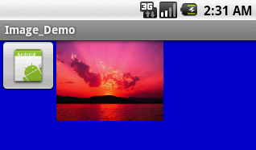
Basic Widgets: Images
...
<ImageButton
android:id="@+id/myImageBtn1"
android:src="@drawable/icon"
android:layout_width="wrap_content"
android:layout_height="wrap_content"
>
</ImageButton>
<ImageView
android:id="@+id/myImageView1"
android:src="@drawable/microsoft_sunset"
android:layout_width="150px"
android:layout_height="120px"
android:scaleType="fitXY"
>
</ImageView>
32

Slide 33
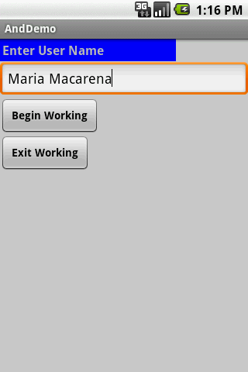
Basic Widgets: EditText
The EditText (or textBox) widget is an extension of TextView that allows updates.
The control configures itself to be editable.
Important Java methods are:
txtBox.setText(“someValue”) and
txtBox.getText().toString()
33

Slide 34
Basic Widgets: EditText
In addition to the standard TextView properties EditText has many others features such as:
• android:autoText, (true/false) provides automatic spelling assistance
• android:capitalize, (words/sentences) automatic capitalization
• android:digits, to configure the field to accept only certain digits
• android:singleLine, is the field for single-line / multiple-line input
• android:password, (true/false) controls field’s visibility
• android:numeric, (integer, decimal, signed) controls numeric format
• android:phonenumber, (true/false) Formatting phone numbers
34

Slide 35
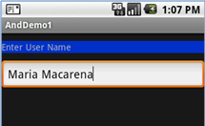
Basic Widgets: EditViews
Example
...
<EditText
android:id="@+id/txtUserName"
android:layout_width="fill_parent"
android:layout_height="wrap_content"
android:textSize="18sp"
android:autoText="true"
android:capitalize="words"
android:hint="First Last Name"
>
</EditText>
...
Upper case words
Enter “teh”
It will be changed to: “The”
Suggestion (grey)
35

Slide 36
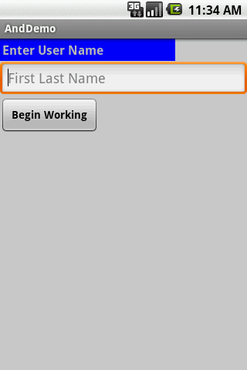

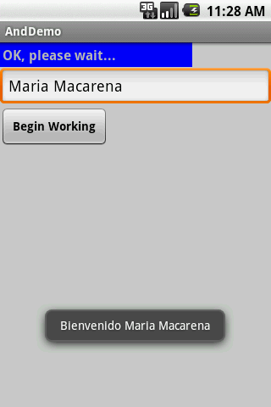
Basic Widgets: Example 1
In this little example we will use an AbsoluteLayout holding a label( TexView), a textBox (EditText), and a Button.
We will use the view as a sort of simplified login screen.
Hint
Setting text
Capitals & spelling
A brief message box
36

Slide 37
Basic Widgets: Example 1
Application’s Layout: main.xml
37

Slide 38
Basic Widgets: Example 1
Android’s Application (1 of 2)
package cis493.gui;
import android.app.Activity;
import android.os.Bundle;
import android.view.View;
import android.view.View.OnClickListener;
import android.widget.Button;
import android.widget.EditText;
import android.widget.TextView;
import android.widget.Toast;
////////////////////////////////////////////////////////////////////////
// "LOGIN" - a gentle introduction to UI controls
public class AndDemo extends Activity {
TextView labelUserName;
EditText txtUserName;
Button btnBegin;
@Override
public void onCreate(Bundle savedInstanceState) {
super.onCreate(savedInstanceState);
setContentView(R.layout.main);
//binding the UI's controls defined in "main.xml" to Java code
labelUserName = (TextView) findViewById(R.id.labelUserName);
txtUserName = (EditText) findViewById(R.id.txtUserName);
btnBegin = (Button) findViewById(R.id.btnBegin);
38

Slide 39
Basic Widgets: Example 1
Android’s Application (2 of 2)
//LISTENER: wiring the button widget to events-&-code
btnBegin.setOnClickListener(new OnClickListener() {
@Override
public void onClick(View v) {
String userName = txtUserName.getText().toString();
if (userName.compareTo("Maria Macarena")==0){
labelUserName.setText("OK, please wait...");
Toast.makeText(getApplicationContext(),
"Bienvenido " + userName,
Toast.LENGTH_SHORT).show();
}
Toast.makeText(getApplicationContext(),
"Bienvenido " + userName,
Toast.LENGTH_SHORT).show();
}
});// onClick
}//onCreate
}//class
39

Slide 40
Basic Widgets: Example 1
Note:
Another way of defining a Listener for multiple button widgets
40

Slide 41
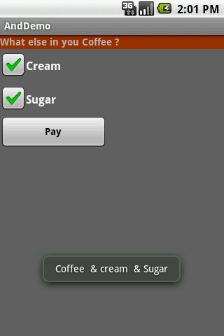
Basic Widgets: CheckBox
A checkbox is a specific type of two-states button that can be either checked or unchecked.
A example usage of a checkbox inside your activity would be the following:
41

Slide 42
Example 2: CheckBox
Complete code for the checkBox demo (1 of 3)
42

Slide 43
Example 2: CheckBox
Complete code for the checkBox demo (2 of 3)
43

Slide 44
Example 2: CheckBox
Complete code for the checkBox demo (1 of 2)
44

Slide 45
Basic Widgets: RadioButtons
A radio button is a two-states button that can be either checked or unchecked.
When the radio button is unchecked, the user can press or click it to check it.
Radio buttons are normally used together in a RadioGroup.
When several radio buttons live inside a radio group, checking one radio button unchecks all the others.
RadioButton inherits from … TextView. Hence, all the standard TextView properties for font face, style, color, etc. are available for controlling the look of radio buttons.
Similarly, you can call isChecked() on a RadioButton to see if it is selected, toggle() to select it, and so on, like you can with a CheckBox.
45

Slide 46
Basic Widgets: RadioButtons
Example
We extend the previous example by adding a RadioGroup and three RadioButtons. Only new XML and Java code is shown:
<?xml version="1.0" encoding="utf-8"?>
<LinearLayout
android:id="@+id/myLinearLayout"
android:layout_width="fill_parent"
android:layout_height="fill_parent"
android:orientation="vertical"
xmlns:android="http://schemas.android.com/apk/res/android"
>
<RadioGroup
android:id="@+id/radGroupCoffeeType"
android:layout_width="fill_parent"
android:layout_height="wrap_content"
android:orientation="vertical"
>
<TextView
android:id="@+id/labelCoffeeType"
android:layout_width="fill_parent"
android:layout_height="wrap_content"
android:background="#ff993300"
android:text="What type of coffee?"
android:textStyle="bold"
>
</TextView>
<RadioButton
android:id="@+id/radDecaf"
android:layout_width="fill_parent"
android:layout_height="wrap_content"
android:text="Decaf"
>
</RadioButton>
<RadioButton
android:id="@+id/radExpresso"
android:layout_width="wrap_content"
android:layout_height="wrap_content"
android:text="Expresso"
>
</RadioButton>
<RadioButton
android:id="@+id/radColombian"
android:layout_width="wrap_content"
android:layout_height="wrap_content"
android:text="Colombian"
>
</RadioButton>
</RadioGroup>
...
</LinearLayout>
46

Slide 47
Basic Widgets: RadioButtons
Android Activity (1 of 3)
package cis493.demoui;
// example using RadioButtons
import android.app.Activity;
import android.os.Bundle;
import android.view.View;
import android.view.View.OnClickListener;
import android.widget.Button;
import android.widget.CheckBox;
import android.widget.RadioButton;
import android.widget.RadioGroup;
import android.widget.Toast;
public class AndDemoUI extends Activity {
CheckBox chkCream;
CheckBox chkSugar;
Button btnPay;
RadioGroup radCoffeeType;
RadioButton radDecaf;
RadioButton radExpresso;
RadioButton radColombian;
47

Slide 48
Basic Widgets: RadioButtons
Android Activity (2 of 3)
@Override
public void onCreate(Bundle savedInstanceState) {
super.onCreate(savedInstanceState);
setContentView(R.layout.main);
//binding XMl controls to Java code
chkCream = (CheckBox)findViewById(R.id.chkCream);
chkSugar = (CheckBox)findViewById(R.id.chkSugar);
btnPay = (Button) findViewById(R.id.btnPay);
radCoffeeType = (RadioGroup)findViewById(R.id.radGroupCoffeeType);
radDecaf = (RadioButton)findViewById(R.id.radDecaf);
radExpresso = (RadioButton)findViewById(R.id.radExpresso);
radColombian = (RadioButton)findViewById(R.id.radColombian);
48

Slide 49
Basic Widgets: RadioButtons
//LISTENER: wiring button-events-&-code
btnPay.setOnClickListener(new OnClickListener() {
@Override
public void onClick(View v) {
String msg = "Coffee ";
if (chkCream.isChecked())
msg += " & cream ";
if (chkSugar.isChecked())
msg += " & Sugar";
// get radio buttons ID number
int radioId = radCoffeeType.getCheckedRadioButtonId();
// compare selected's Id with individual RadioButtons ID
if (radColombian.getId()== radioId)
msg = “Colombian " + msg;
// similarly you may use .isChecked() on each RadioButton
if (radExpresso.isChecked())
msg = "Expresso " + msg;
Toast.makeText(getApplicationContext(), msg, Toast.LENGTH_SHORT).show();
// go now and compute cost...
}// onClick
});
}// onCreate
}// class
49

Slide 50
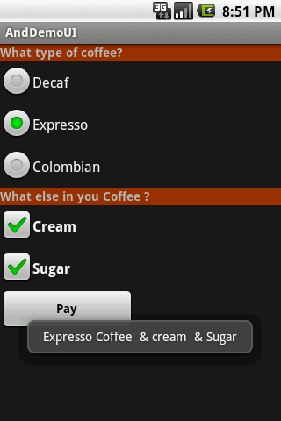
Basic Widgets: RadioButtons
Example
This UI uses RadioButtons and
CheckBoxes
to define choices
RadioGroup
Summary of choices
50

Slide 51
UI – Other Features
All widgets extend View therefore they acquire a number of useful View properties and methods including:
XML Controls the focus sequence:
android:visibility
Android:background
Java methods
myButton.requestFocus()
myTextBox.isFocused()
myWidget.setEnabled()
myWidget.isEnabled()

Slide 52
Android Basic XML Layouts

Slide 53
Basic XML Layouts - Containers
Designing Complex Uis
Arguably, LinearLayout is the most common modeling tool. It offers a "box" model similar to the Java-Swing Box-Layout.
Generally, complex UI designs result from the combination of simpler nested boxes that show their inner pieces using a horizontal or vertical orientation.
53

Slide 54
Basic XML Layouts - Containers
Summary of Commonly-used Android containers
LinearLayout (the box model),
RelativeLayout (a rule-based model), and
TableLayout (the grid model), along with
ScrollView, a container designed to assist with implementing scrolling containers.
Other (ListView, GridView, WebView, MapView,…) discussed later
54

Slide 55
Basic XML Layouts - Containers
Linear Layout
LinearLayout is a box model – widgets or child containers are lined up in a column or row, one after the next.
To configure a LinearLayout, you have five main areas of control besides the container's contents:
orientation,
fill model,
weight,
gravity,
padding ,
margin
55

Slide 56
Basic XML Layouts - Containers
Linear Layout
Orientation
indicates whether the LinearLayout represents a row or a column.
Add the android:orientation property to your LinearLayout
element in your XML layout, setting the value to be horizontal for a row or vertical for a column.
The orientation can be modified at runtime by invoking setOrientation()
56

Slide 57
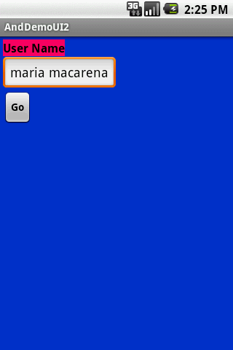
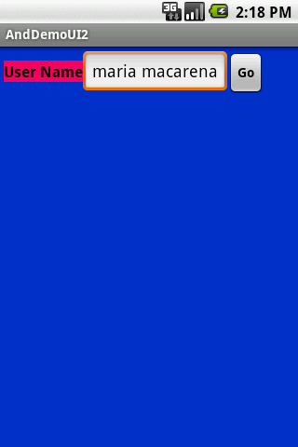
Basic XML Layouts - Containers
1.1 Linear Layout: Orientation
indicates whether the LinearLayout represents a row (HORIZONTAL) or a column (VERTICAL).
horizontal
<?xml version="1.0" encoding="utf-8"?>
<LinearLayout
android:id="@+id/myLinearLayout"
android:layout_width="fill_parent"
android:layout_height="fill_parent"
android:background="#ff0033cc"
android:padding="4dip"
xmlns:android="http://schemas.android.com/apk/res/android"
android:orientation="horizontal" >
<TextView
android:id="@+id/labelUserName"
android:layout_width="wrap_content"
android:layout_height="wrap_content"
android:background="#ffff0066"
android:text="User Name"
android:textSize="16sp"
android:textStyle="bold"
android:textColor="#ff000000"
>
</TextView>
<EditText
android:id="@+id/ediName"
android:layout_width="wrap_content"
android:layout_height="wrap_content"
android:textSize="18sp"
>
</EditText>
<Button
android:id="@+id/btnGo"
android:layout_width="wrap_content"
android:layout_height="wrap_content"
android:text="Go"
android:textStyle="bold"
>
</Button>
</LinearLayout>
vertical
57

Slide 58
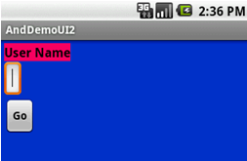
Basic XML Layouts - Containers
1.2 Linear Layout: Fill Model
Widgets have a "natural" size based on their accompanying text.
When their combined sizes does not exactly match the width of the Android device's screen, we may have the issue of what to do with the remaining space.
natural sizes
empty screen space
58

Slide 59
Basic XML Layouts - Containers
1.2 Linear Layout: Fill Model
All widgets inside a LinearLayout must supply dimensional attributes
android:layout_width and android:layout_height
to help address the issue of empty space.
Values used in defining height and width are:
Specific a particular dimension, such as 125dip (device independent pixels)
Provide wrap_content, which means the widget should fill up its natural space, unless that is too big, in which case Android can use word-wrap as needed to make it fit.
Provide fill_parent, which means the widget should fill up all available space in its enclosing container, after all other widgets are taken care of.
59

Slide 60
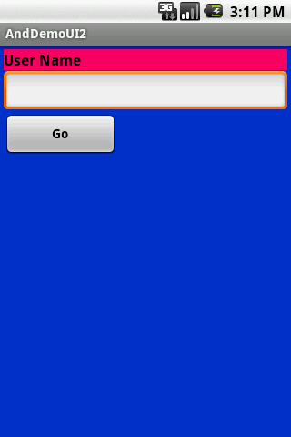
Basic XML Layouts - Containers
<?xml version="1.0" encoding="utf-8"?>
<LinearLayout
android:id="@+id/myLinearLayout"
android:layout_width="fill_parent"
android:layout_height="fill_parent"
android:background="#ff0033cc"
android:padding="4dip"
android:orientation="vertical"
xmlns:android="http://schemas.android.com/apk/res/android"
>
<TextView
android:id="@+id/labelUserName"
android:layout_width="fill_parent"
android:layout_height="wrap_content"
android:background="#ffff0066"
android:text="User Name"
android:textSize="16sp"
android:textStyle="bold"
android:textColor="#ff000000"
>
</TextView>
<EditText
android:id="@+id/ediName"
android:layout_width="fill_parent"
android:layout_height="wrap_content"
android:textSize="18sp"
>
</EditText>
<Button
android:id="@+id/btnGo"
android:layout_width="125dip"
android:layout_height="wrap_content"
android:text="Go"
android:textStyle="bold"
>
</Button>
</LinearLayout>
1.2 Linear Layout: Fill Model
Row-wise
125 dip
entire row (320 dip on G1)
Use all the row
Specific size: 125dip
G1 phone resolution is: 320 x 480 dip (3.2 in).
60

Slide 61
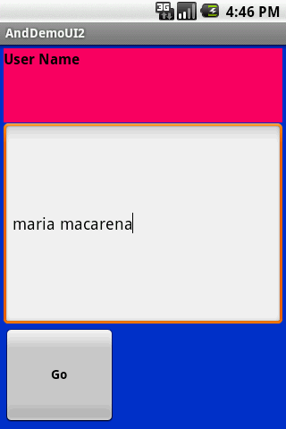
Basic XML Layouts - Containers
1.2 Linear Layout: Weight
It is used to proportionally assign space to widgets in a view.
You set android:layout_weight to a value (1, 2, 3, …) to indicates what proportion of the free space should go to that widget.
Example
Both the TextView and the Button widgets have been set as in the previous example. Both have the additional property android:layout_weight="1" whereas the EditText control has android:layout_weight="2"
Default value is 0
Takes: 2 /(1+1+2)
of the screen space
61

Slide 62
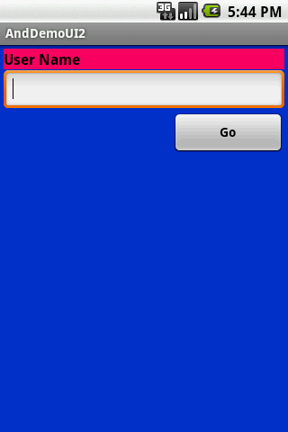
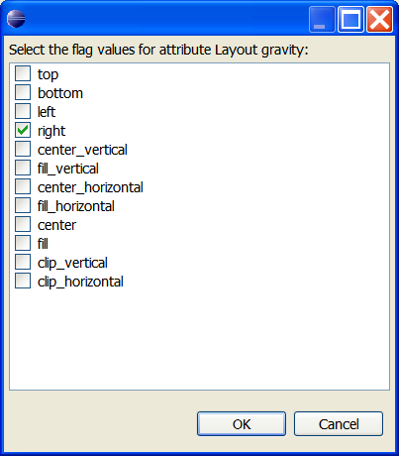
Basic XML Layouts - Containers
1.3 Linear Layout: Gravity
It is used to indicate how a control will align on the screen.
By default, widgets are left- and top-aligned.
You may use the XML property
android:layout_gravity=“…”
to set other possible arrangements:
left, center, right, top, bottom, etc.
Button has right gravity
62

Slide 63



Basic XML Layouts - Containers
1.3 CAUTION: gravity vs. layout_gravity
The difference between:
android:gravity
specifies how to place the content of an object, both on the x- and y-axis, within the object itself.
android:layout_gravity
positions the view with respect to its parent (i.e. what the view is contained in).
android:gravity="center"
android:layout_gravity="center"
63

Slide 64
Basic XML Layouts - Containers
1.4 Linear Layout: Padding
The padding specifies how much space there is between the boundaries of the widget's "cell" and the actual widget contents.
If you want to increase the internal whitespace between the edges of the and its contents, you will want to use the:
android:padding property
or by calling setPadding() at runtime on the widget's Java object.
Note: Padding is analogous to the margins on a word processing document.
64

Slide 65
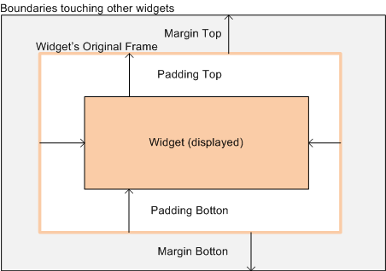
Basic XML Layouts - Containers
1.3 Linear Layout: Padding and Marging
65

Slide 66
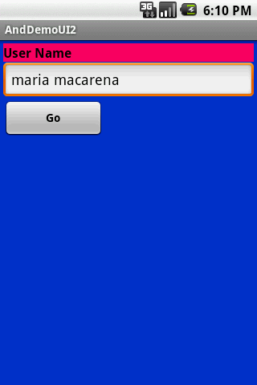
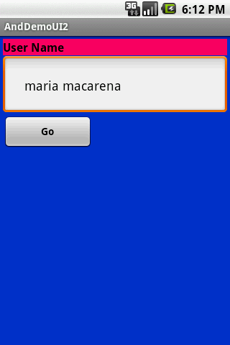
Basic XML Layouts - Containers
1.3 Linear Layout: Internal Margins Using Padding
Example:
The EditText box has been changed to display 30dip of padding all around
<EditText
android:id="@+id/ediName"
android:layout_width="fill_parent"
android:layout_height="wrap_content"
android:textSize="18sp"
android:padding="30dip“
>
</EditText>
...
66

Slide 67
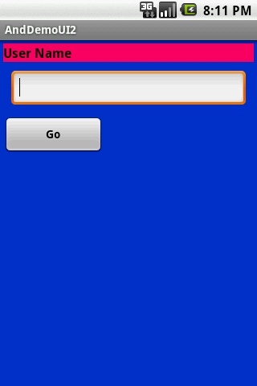
Basic XML Layouts - Containers
1.4 Linear Layout: (External) Marging
By default, widgets are tightly packed next to each other.
To increase space between them use the android:layout_margin attribute
Increased inter-widget space
<EditText
android:id="@+id/ediName"
android:layout_width="fill_parent"
android:layout_height="wrap_content"
android:textSize="18sp"
android:layout_margin=“6dip“
>
</EditText>
...
67
67

Slide 68
Basic XML Layouts - Containers
2. Relative Layout
RelativeLayout places widgets based on their relationship to other widgets in the container and the parent container.
Example:
A is by the parent’s top
C is below A, to its right
B is below A, to the left of C
A
B
C
68

Slide 69
Basic XML Layouts - Containers
2. Relative Layout - Referring to the container
Some positioning XML (boolean) properties mapping a widget according to its location respect to the parent’s place are:
android:layout_alignParentTop says the widget's top should align with the top of the container
android:layout_alignParentBottom the widget's bottom should align with the bottom of the container
android:layout_alignParentLeft the widget's left side should align with the left side of the container
android:layout_alignParentRight the widget's right side should align with the right side of the container
android:layout_centerInParent the widget should be positioned both horizontally and vertically at the center of the container
android:layout_centerHorizontal the widget should be positioned horizontally at the center of the container
android:layout_centerVertical the widget should be positioned vertically at the center of the container
69

Slide 70
Basic XML Layouts - Containers
2. Relative Layout – Referring to other widgets
The following properties manage positioning of a widget respect to other widgets:
android:layout_above indicates that the widget should be placed above the widget referenced in the property
android:layout_below indicates that the widget should be placed below the widget referenced in the property
android:layout_toLeftOf indicates that the widget should be placed to the left of the widget referenced in the property
android:layout_toRightOf indicates that the widget should be placed to the right of the widget referenced in the property
70

Slide 71
Basic XML Layouts - Containers
2. Relative Layout – Referring to other widgets – cont.
android:layout_alignTop indicates that the widget's top should be aligned with the top of the widget referenced in the property
android:layout_alignBottom indicates that the widget's bottom should be aligned with the bottom of the widget referenced in the property
android:layout_alignLeft indicates that the widget's left should be aligned with the left of the widget referenced in the property
android:layout_alignRight indicates that the widget's right should be aligned with the right of the widget referenced in the property
android:layout_alignBaseline indicates that the baselines of the two widgets should be aligned
71

Slide 72
Basic XML Layouts - Containers
2. Relative Layout – Referring to other widgets
In order to use Relative Notation in Properties you need to consistently:
Put identifiers (android:id attributes) on all elements that you will need to address.
Syntax is: @+id/... (for instance an EditText box could be XML called: android:id="@+id/ediUserName")
Reference other widgets using the same identifier value (@+id/...) already given to a widget. For instance a control below the EditText box could say: android:layout_below="@+id/ediUserName"
72

Slide 73
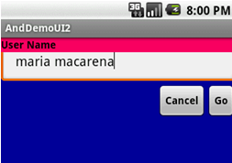
Basic XML Layouts - Containers
2. Relative Layout – Example
<?xml version="1.0" encoding="utf-8"?>
<RelativeLayout
android:id="@+id/myRelativeLayout"
android:layout_width="fill_parent"
android:layout_height="fill_parent"
android:background="#ff000099"
xmlns:android="http://schemas.android.com/apk/res/android">
<TextView
android:id="@+id/lblUserName"
android:layout_width="fill_parent"
android:layout_height="wrap_content"
android:background="#ffff0066"
android:text="User Name"
android:textStyle="bold"
android:textColor="#ff000000"
android:layout_alignParentTop="true"
android:layout_alignParentLeft="true">
</TextView>
<EditText
android:id="@+id/ediUserName"
android:layout_width="fill_parent"
android:layout_height="wrap_content"
android:layout_below="@+id/lblUserName"
android:layout_alignParentLeft="true"
android:layout_alignLeft="@+id/myRelativeLayout"
android:padding="20dip">
</EditText>
<Button
android:id="@+id/btnGo"
android:layout_width="wrap_content"
android:layout_height="wrap_content"
android:layout_below="@+id/ediUserName"
android:layout_alignRight="@+id/ediUserName"
android:text="Go"
android:textStyle="bold">
</Button>
<Button
android:id="@+id/btnCancel"
android:layout_width="wrap_content"
android:layout_height="wrap_content"
android:layout_toLeftOf="@+id/btnGo"
android:layout_below="@+id/ediUserName"
android:text="Cancel"
android:textStyle="bold">
</Button>
</RelativeLayout>
73

Slide 74
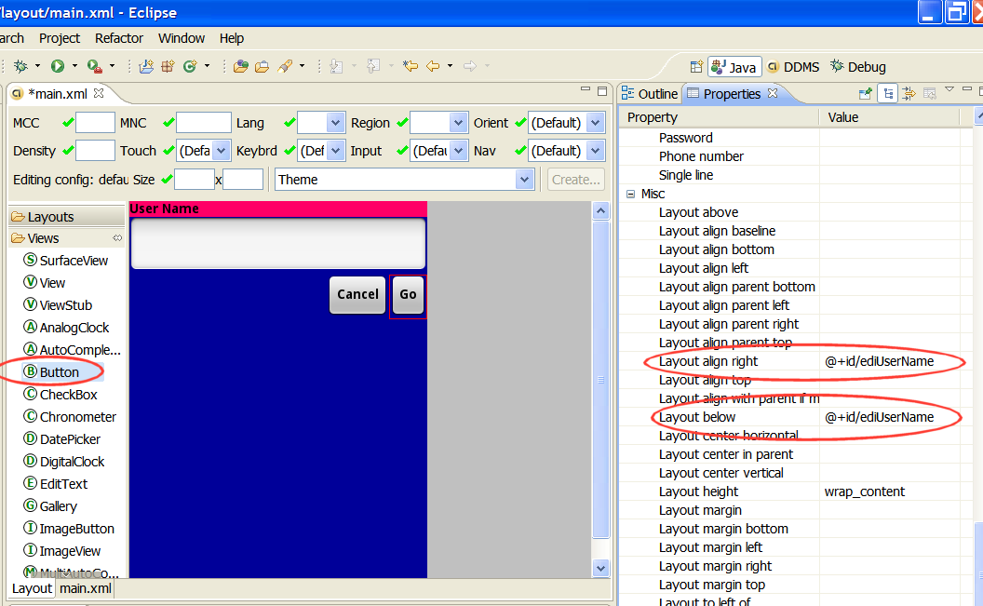
Basic XML Layouts - Containers
2. Relative Layout – Comment (as of Aug. 2009)
Use the Eclipse ADT Layout Editor for laying out RelativeLayouts.
DroidDraw is of very little help in this respect.
74

Slide 75
Basic XML Layouts - Containers
3. Table Layout
Android's TableLayout allows you to position your widgets in a grid made of identifiable rows and columns.
Columns might shrink or stretch to accommodate their contents.
TableLayout works in conjunction with TableRow.
TableLayout controls the overall behavior of the container, with the widgets themselves positioned into one or more TableRow containers, one per row in the grid.
75

Slide 76
Basic XML Layouts - Containers
3. Table Layout
Rows are declared by you by putting widgets as children of a TableRow inside the overall TableLayout.
The number of columns is determined by Android ( you control the number of columns in an indirect way).
So if you have three rows, one with two widgets, one with three widgets, and one with four widgets, there will be at least four columns.
0 |  | 1
0 |  | 1 | 2
0 | 1 | 2 | 3
76

Slide 77
Basic XML Layouts - Containers
3. Table Layout
However, a single widget can take up more than one column by including the android:layout_span property, indicating the number of columns the widget spans (this is similar to the colspan attribute one finds in table cells in HTML)
<TableRow>
<TextView android:text="URL:" />
<EditText
android:id="@+id/entry"
android:layout_span="3" />
</TableRow>
77

Slide 78
Basic XML Layouts - Containers
3. Table Layout
Ordinarily, widgets are put into the first available column of each row.
In the example below, the label (“URL”) would go in the first column (column 0, as columns are counted starting from 0), and the TextField would go into a spanned set of three columns (columns 1 through 3).
android:layout_span="3"
Label (URL) | EditText | EditText-span | EditText-span
Column 0 | Column 1 | Column 2 Button Cancel | Column 3 Button OK
android:layout_columns="2"
78

Slide 79
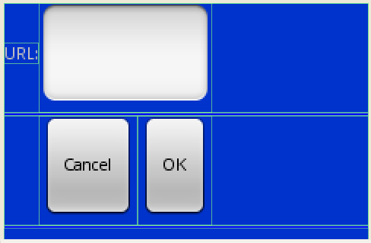
Basic XML Layouts - Containers
<?xml version="1.0" encoding="utf-8"?>
<TableLayout
android:id="@+id/myTableLayout"
android:layout_width="fill_parent"
android:layout_height="fill_parent"
android:background="#ff0033cc"
android:orientation="vertical"
xmlns:android="http://schemas.android.com/apk/res/android"
>
<TableRow>
<TextView
android:text="URL:" />
<EditText android:id="@+id/ediUrl"
android:layout_span="3"/>
</TableRow>
<View
android:layout_height="3dip"
android:background="#0000FF" />
<TableRow>
<Button android:id="@+id/cancel"
android:layout_column="2"
android:text="Cancel" />
<Button android:id="@+id/ok"
android:text="OK" />
</TableRow>
<View
android:layout_height="3dip"
android:background="#0000FF" />
</TableLayout>
3. Table Layout –
Example
Strech up to column 3
Skip columns: 0, 1
Note to the reader:
Experiment changing
layout_span to 1, 2, 3
79

Slide 80
Basic XML Layouts - Containers
3. Table Layout
By default, each column will be sized according to the "natural" size of the widest widget in that column.
If your content is narrower than the available space, you can use the TableLayout property:
android:stretchColumns =“…”
Its value should be a single column number (0-based) or a comma-delimited list of column numbers. Those columns will be stretched to take up any available space yet on the row.
80

Slide 81
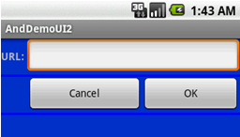
Basic XML Layouts - Containers
3. Table Layout
In our running example we stretch columns 2, 3, and 4 to fill the rest of the row.
...
<TableLayout
android:id="@+id/myTableLayout"
android:layout_width="fill_parent"
android:layout_height="fill_parent"
android:background="#ff0033cc"
android:orientation="vertical"
android:stretchColumns ="2,3,4"
xmlns:android="http://schemas.android.com/apk/res/android"
>
...
TODO: try to stretch one column at the time 1, then 2, and so on.
81

Slide 82
Basic XML Layouts - Containers
4. ScrollView Layout
When we have more data than what can be shown on a single screen you may use the ScrollView control.
It provides a sliding or scrolling access to the data. This way the user can only see part of your layout at one time, but the rest is available via scrolling.
This is similar to browsing a large web page that forces the user to scroll up the page to see the bottom part of the form.
82

Slide 83
Basic XML Layouts - Containers
4. Example ScrollView Layout
<?xml version="1.0" encoding="utf-8"?>
<ScrollView
android:id="@+id/myScrollView1"
android:layout_width="fill_parent"
android:layout_height="fill_parent"
android:background="#ff009999"
xmlns:android="http://schemas.android.com/apk/res/android"
>
<LinearLayout
android:id="@+id/myLinearLayoutVertical"
android:layout_width="fill_parent"
android:layout_height="fill_parent"
android:orientation="vertical"
>
<LinearLayout
android:id="@+id/myLinearLayoutHorizontal1"
android:layout_width="fill_parent"
android:layout_height="fill_parent"
android:orientation="horizontal"
>
<ImageView
android:id="@+id/myPicture"
android:layout_width="wrap_content"
android:layout_height="wrap_content"
android:src="@drawable/icon" />
<TextView
android:id="@+id/textView1"
android:layout_width="fill_parent"
android:layout_height="wrap_content"
android:text="Line1"
android:textSize="70dip" />
</LinearLayout>
<View
android:layout_width="fill_parent"
android:layout_height="6dip"
android:background="#ffccffcc" />
<TextView
android:id="@+id/textView2"
android:layout_width="fill_parent"
android:layout_height="wrap_content"
android:text="Line2"
android:textSize="70dip" />
<View
android:layout_width="fill_parent"
android:layout_height="6dip"
android:background="#ffccffcc" />
<TextView
android:id="@+id/textView3"
android:layout_width="fill_parent"
android:layout_height="wrap_content"
android:text="Line3"
android:textSize="70dip" />
<View
android:layout_width="fill_parent"
android:layout_height="6dip"
android:background="#ffccffcc" />
<TextView
android:id="@+id/textView4"
android:layout_width="fill_parent"
android:layout_height="wrap_content"
android:text="Line4"
android:textSize="70dip" />
<View
android:layout_width="fill_parent"
android:layout_height="6dip"
android:background="#ffccffcc" />
<TextView
android:id="@+id/textView5"
android:layout_width="fill_parent"
android:layout_height="wrap_content"
android:text="Line5"
android:textSize="70dip" />
</LinearLayout>
</ScrollView>
83

Slide 84
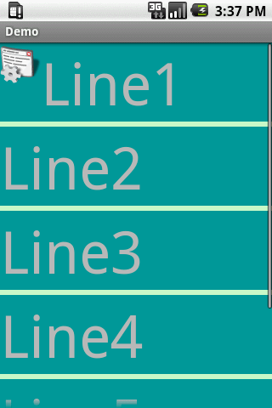
Basic XML Layouts - Containers
4. Example ScrollView Layout
Combining an
ImageView & TextView
in a horizontal Linear Layout
Simple TextView
Scroller
84

Slide 85
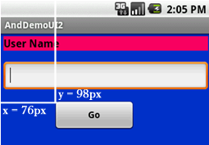
Basic XML Layouts - Containers
5. Miscellaneous.
Absolute Layout
A layout that lets you specify exact locations (x/y coordinates) of its children.
Absolute layouts are less flexible and harder to maintain than other types of layouts without absolute positioning.
85

Slide 86
Basic XML Layouts - Containers
5. Miscellaneous Absolute Layout (cont.)
<?xml version="1.0" encoding="utf-8"?>
<AbsoluteLayout
android:id="@+id/myLinearLayout"
android:layout_width="fill_parent"
android:layout_height="fill_parent"
android:background="#ff0033cc"
android:padding="4dip"
xmlns:android="http://schemas.android.com/apk/res/android"
>
<TextView
android:id="@+id/tvUserName"
android:layout_width="fill_parent"
android:layout_height="wrap_content"
android:background="#ffff0066"
android:text="User Name"
android:textSize="16sp"
android:textStyle="bold"
android:textColor="#ff000000"
android:layout_x="0dip"
android:layout_y="10dip"
>
</TextView>
<EditText
android:id="@+id/etName"
android:layout_width="fill_parent"
android:layout_height="wrap_content"
android:textSize="18sp"
android:layout_x="0dip"
android:layout_y="38dip"
>
</EditText>
<Button
android:layout_width="120dip"
android:text="Go"
android:layout_height="wrap_content"
android:textStyle="bold"
android:id="@+id/btnGo"
android:layout_x="100dip"
android:layout_y="170dip" />
</AbsoluteLayout>
Button location
86

Slide 87
Questions ?

